Slide 1
Informative Speech on Tobacco Use
Tobacco use in United States

Slide 2
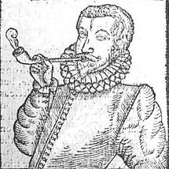
Introduction
Tobacco use is everywhere and it is a common substance in the United States.
The number of tobacco users has been increasing significantly.
Much remains unknown concerning the origination and use of tobacco.
The impacts of tobacco remain a constant threat to the American nation.
Tobacco use in the United States led to:
  Rampant colonization.
  Rapid advancement in the tobacco industry.
  Development of the American culture.
Notes:
Hello everyone. We all know that tobacco is a common substance, not only in the United States by also in other parts of the world. In my conviction, tobacco use is one of the most significant areas that needs additional knowledge. According to statistics, the number of tobacco users has been increasing significantly amounting to 16% of the total adult Americans by 2018, yet the wellbeing of the US populations remains in question (Soneji, Sargent, & Tanski, 2016). Much remains unknown concerning the origin and use of tobacco. The impacts of tobacco remain a constant threat to the American nation. Tobacco use in the United States led to rampant colonization, rapid advancement in the tobacco industry, and development of the American culture.

Slide 3
History of Tobacco use in the United States.
Tobacco is not a native plant in the United States.
The plant was introduced in America by Columbus in 1492
Columbus encouraged the natives to trade tobacco themselves
Tobacco use gained a strong foothold during the revolutionary war in 1776.
Tobacco use gained additional popularity after the invention of the cigarette machines
Notes:
It is true that tobacco is not a native plant in the United States. The plant was introduced in America by Columbus in 1492. When Columbus learned about the utility of dried tobacco leaves to the natives, he encouraged them to increase its buying and selling. Tobacco use gained a strong foothold in the during the revolutionary war in 1776.
Chewing tobacco became popular in the 19th century. Tobacco use gained additional popularity after the invention of the cigarette machines

Slide 4
Effects of Tobacco Use in the United States
Rampant colonization.
  Tobacco is not a native plant in the United States.
  Tobacco was introduced in America by colonies.
  British colonies had discovered that the US was endowed with fertile land for farming (Singh, 2016).
  Tobacco was viewed as the savior for the colonies.
  Tobacco was the most lucrative export for colonies.
  Colonies embraced the contributions of slavery.
Notes:
As we know, tobacco is not a native plant in the United States. The plant was introduced in America by colonies, but its use has had varied impacts on the development of the US, starting from the 20th century. Tobacco use paved the way for rampant colonization of the US (Singh, 2016). British colonies had discovered that the US was endowed with fertile land, which would possibly support large scale production of tobacco. Since then, tobacco popularity grew so rapidly, making it the savior for the colonies because it had become the most lucrative export for colonies. It is also noteworthy that colonies embraced the contributions of slavery, and hence, deepened colonization.

Slide 5
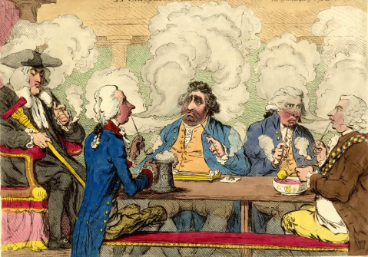
Continuation on Effects of Tobacco use in the United States
Rapid advancement in the tobacco industry.
Tobacco use attributed to almost 65% of the economic activities in the US tobacco industries.
The global market for tobacco was considered the backbone of the tobacco industry.
The invention of cigarette-rolling machines increased the creation of cigarettes for most Americans.
Tobacco established the basis of the colony’s economy.
Notes:
It is also noteworthy that increased tobacco use in America was facilitated by rapid advancement in the tobacco industry. Tobacco use attributed to almost 65% of the economic activities in the US economy. More importantly, tobacco products were very profitable in both the US and the global market was considered to be the backbone of the lucrative tobacco industry. Also, the invention of cigarette-rolling machines increased the creation of cigarettes for most Americans
Tobacco established the basis of the colony’s economy. As such, colonies relied on tobacco returns to purchase the indentured servants as well as slaves to support tobacco production, to meet local taxes and to buy manufactured goods from England.

Slide 6

Continuation on Effects of Tobacco Use in the United States
Development of the strong American culture.
Tobacco had medicinal, ceremonial, and intoxication values.
Europeans adopted it as a healing factor for the majority of diseases.
Tobacco was believed to serve as a brain stimulant.
Notes:
Besides, tobacco use has had a varied socio-cultural impact in the US as defined by history. In the late 15th century, when tobacco was introduced in the US, the product was able to launch as well as polish its relevance in Americans way of life. Majority of the Native Americans perceived tobacco as a product which had medicinal, ceremonial, and intoxication values. Further, some Europeans adopted it as a healing factor for the majority of diseases. Based on this controversy, some committed physicians defended that tobacco could cleanse and resist poison. During World War I, cigarettes were included in a soldier’s rations for food since it was believed to serve as a brain stimulant. Researchers embraced the curative nature of tobacco. However, it was found that there were other better traditional medicines which could serve to heal and restore the health of Americans with little to no side effects.

Slide 7
Conclusion
Tobacco use in the United States led to:
Rampant colonization.
Rapid advancement in the tobacco industry.
Development of the American culture.
Notes:
Tobacco use in the United States led to rampant colonization, rapid advancement in the tobacco industry, and development of the American culture. Tobacco use has been the leading cause of serious illness, such as cancer and mental disorders. Increased tobacco use tends to violate ether wellness of society through social evils. Tobacco is addictive, and it has turned out to be an added cost to the American economy. It is with no doubt that tobacco use has been and remains to be a growing challenge in America, and hence, Americans should be informed about the need for them to abstain from the different forms of tobacco use for good health.

Slide 8
References
Dunkle, A., Kalpinski, R., Ebbert, J., Talcott, W., Klesges, R., & Little, M. A. (2018). Predicting smokeless tobacco initiation and re-initiation in the United States Air Force. Addictive Behaviors Reports.
Wang, T. W., Gentzke, A., Sharapova, S., Cullen, K. A., Ambrose, B. K., & Jamal, A. (2018). Tobacco product use among middle and high school students—United States, 2011–2017. Morbidity and Mortality Weekly Report, 67(22), 629.
Soneji, S., Sargent, J., & Tanski, S. (2016). Multiple tobacco product use among US adolescents and young adults. Tobacco control, 25(2), 174-180.
Singh, T. (2016). Tobacco use among middle and high school students—United States, 2011–2015. MMWR. Morbidity and mortality weekly report, 65.

